Slide 1
caBIG® Imaging Enterprise Use Case Project: TCGA Radiology Director Briefing
July 15th 2010

Slide 2
Agenda For This Briefing
I. TCGA Radiology Project Summary
A. Project Purpose
B. Scope of this project
- Committed Tasks and Additional Tasks
C. Achievements
i. Radiology Reading
ii. AIM Tasks
iii. AIM Export Script
iv. TCGA Cancer Cell Data Service
v. caB2B Query of NBIA, AIM and TCGA CC Data Services
vi. Cross Program Coordination
vii. Preliminary Scientific Findings
viii. Additional Analysis with caIntegrator2
II. Opportunities to Further Deploy TCGA Related Imaging and Life Sciences Technologies
III. How the TCGA Radiology Project Fits Into the caBIG® Imaging Program Roadmap
IV. Proposed Next Steps

Slide 3
Purpose of TCGA Radiology Project
Overarching Project Goal
Utilize multiple CBIIT/caBIG® technologies together to create a practical system to capture diagnostic imaging “knowledge” in a structured, standardized manner and to allow for the integration with genomic and clinical data.

Slide 4
Review of Scope
Committed Tasks
88 TCGA Radiology* cases in NBIA read by two neuroradiologists using the Clear Canvas Workstation.
Develop bi-directional search capability in the AIM Data Service.
Develop Unique ID Fields within AIM Data Service.
Additional Tasks
Creation of a data service utilizing data from the Cancer Cell article published 12/09.
Stand up data service as a grid service at Emory.
Deploy AIME RESTful web interface.
Develop a XML to table report mechanism for AIME Data Service using.
*82 out of the 88 cases had complete data sets

Slide 5
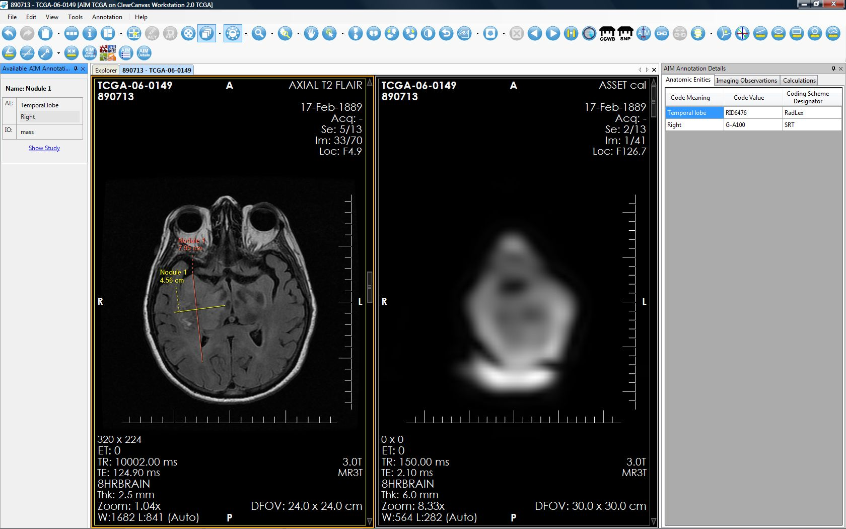
Achievements: Radiology Reading
TCGA cases in NBIA have been read by at least two funded neuro-radiologists:
A radiologist fills out AIM based reporting template.
New annotation data is saved on AIME.
New markups created on Workstation and saved to the AIME.
Existing markups and annotation retrieved from AIM Data Service at Emory (AIME).
Images retrieved from NBIA at CBIIT

Slide 6
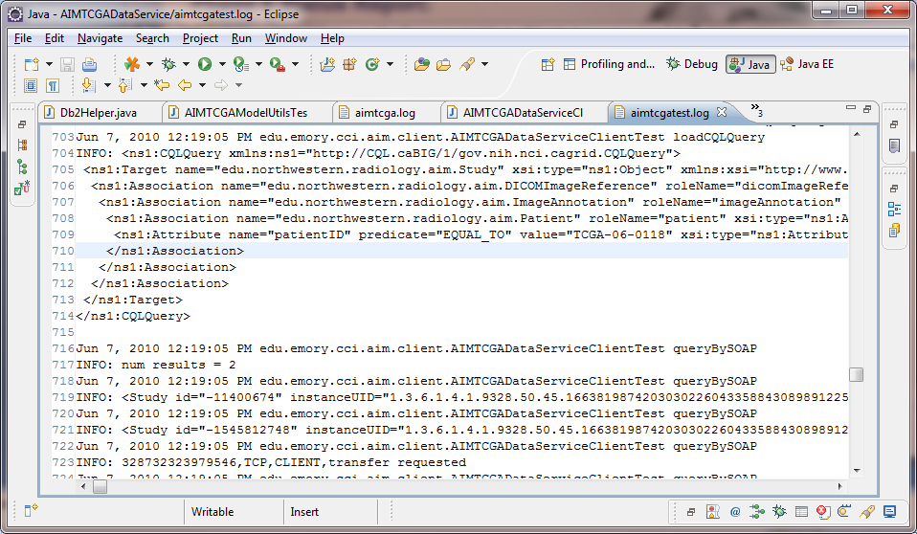
Achievements: AIM Tasks
The AIME bidirectional query task is completed (to reach full CQL compliance)
The AIME unique ID field population tasks is completed (to support queries from caB2B)
Tony, can you add a screen shot with call out boxes like I did for CC?
Retrieved 2 out of 23 documents from Test data service.
Query “up” AND “down” the document hierarchy, following bidirectional associations in Domain Model. Unsupported previously.
“id” field populated with unique values instead of “0”

Slide 7
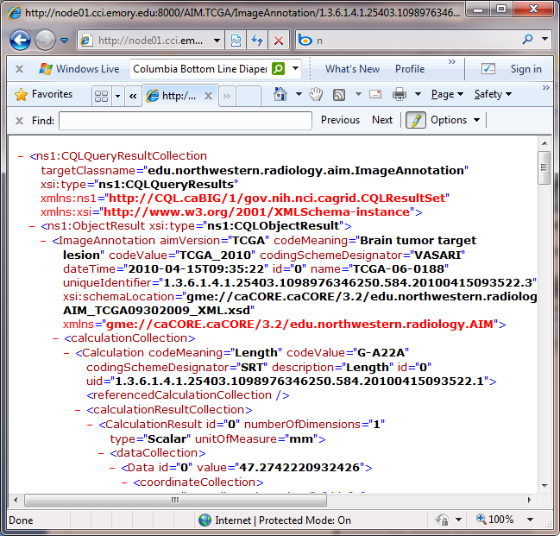
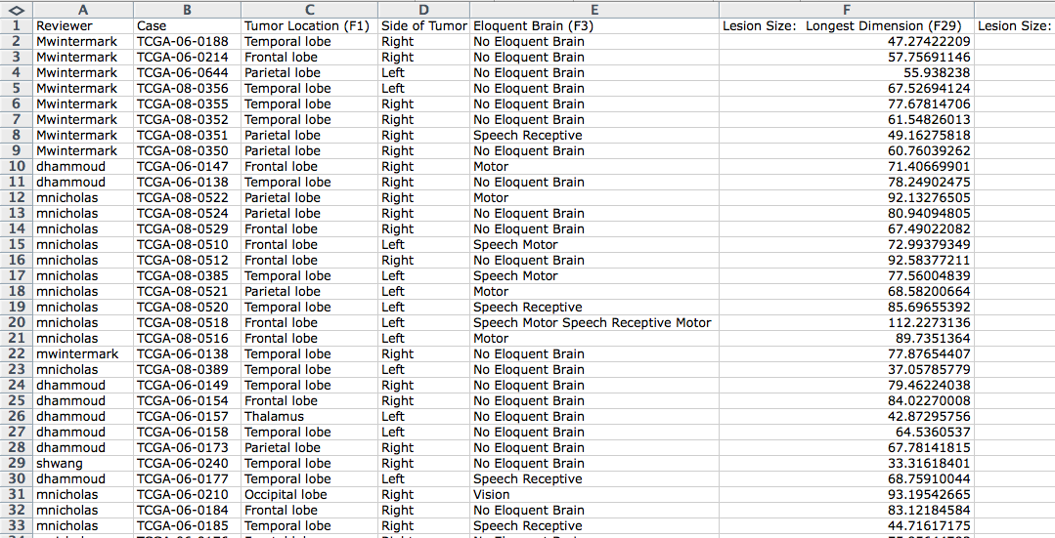
Achievements: AIM Export Script
Script created to read AIME data an output into a spreadsheet.

Slide 8
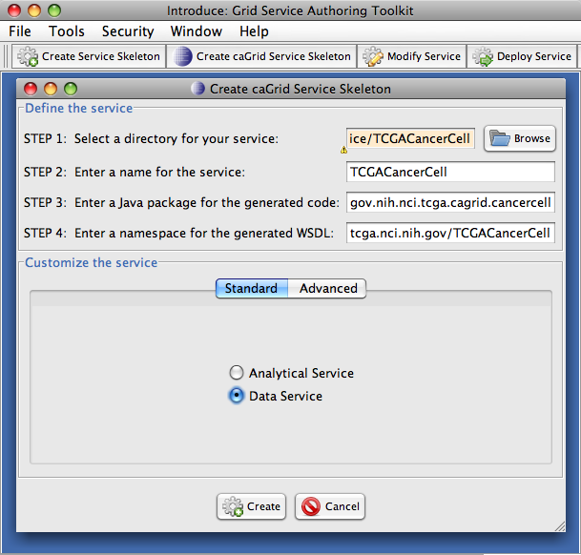
Achievements: TCGA Cancer Cell Data Service
Because the existing TCGA Grid Data Service is not currently available, we created our own grid data service to host genomic and clinical data from the 12/09 Cancer Cell article.
Built a data model for Cancer Cell genomic and clinical data
Used caCORE SDK 4.2 to quickly generate an application from this model
Used caGrid Introduce SDK to create a Grid data service from the SDK model
Deployed data service at Emory
Create scientific queries for caB2B
Successfully queried 3 disparate caGrid data services (AIM, NBIA, TCGA Cancer Cell) with caB2B
Documented insights gained from the process of setting up our own data and grid service

Slide 9
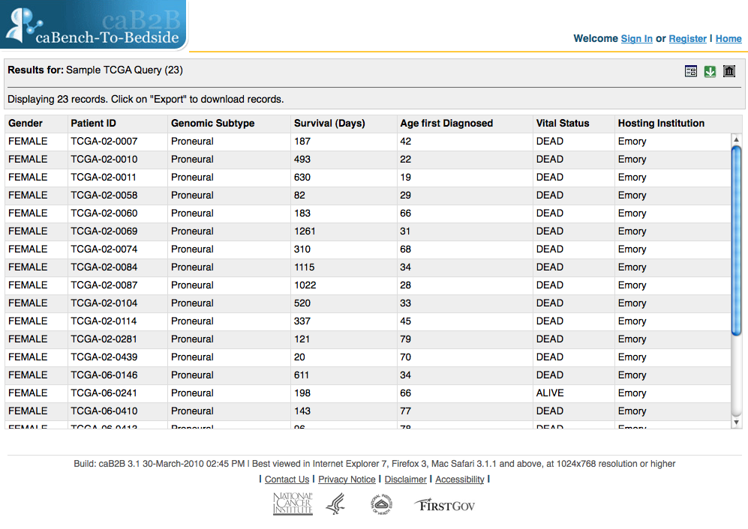
Achievements: caB2B Query of NBIA, AIM and TCGA CC Data Services
Imported models for AIM and TCGA data services into caB2B and manually loaded URLs for these services
Created groups of related classes across NBIA, AIM and TCGA CC data models
Built scientific queries to exercise queries joining NBIA, AIM and TCGA CC data using the B2B thick client
Exposed these queries through caB2B 3.1 web client
Successfully queried 3 disparate caGrid data services (AIM, NBIA, TCGA Cancer Cell) with caB2B
There are limitations regarding speed of return of data
Documented performance limitations in detail along with other insights gained during the process of configuring caB2B for this project.

Slide 10
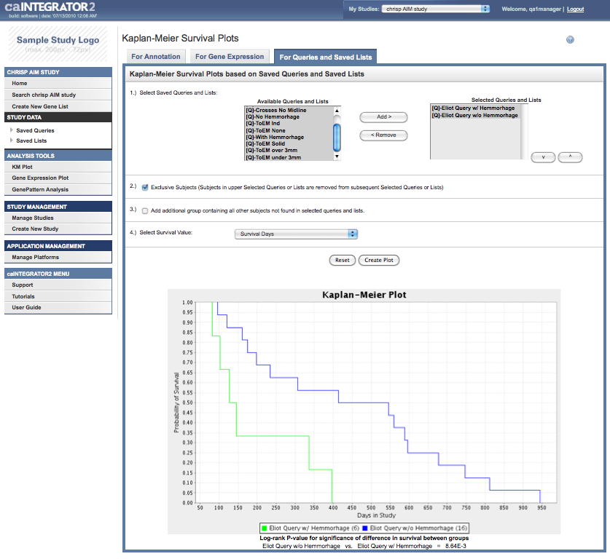
Achievements: Additional Analysis with caIntegrator2
caIntegrator2 team added a feature to support integration with AIM grid data service to load annotations (currently in scheduled 1.2 release)
caIntegrator2 Study: TCGA Cancer Cell data (from CSV), AIM data from grid service, and images from NBIA production grid service. (Currently the caIntegrator2 TCGA CC study is on the QA tier)
Created scientifically relevant queries based on image observations and clinical data
Generated Kaplan-Meier plots of survival based on certain observations and genomic subtypes

Slide 11
Achievements: Cross Program Coordination
Diverse Group of Contributors
Imaging and ICR Facilitators (Ed and Juli)
Life Science CAT (led by Robert)
Cancer Imaging Program
Imaging SMEs (Emory, Stanford, NW, UMD, UVA, TJU)
Multiple Contractors (Booz Allen, SAIC, 5AM, Sapient)
Grid KC (OSU)

Slide 12
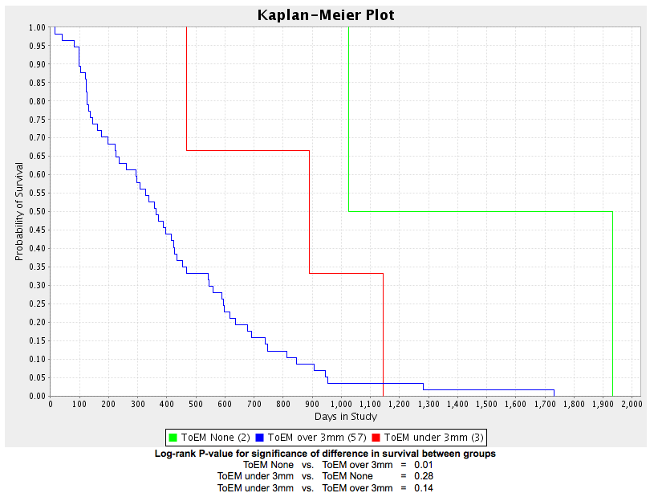
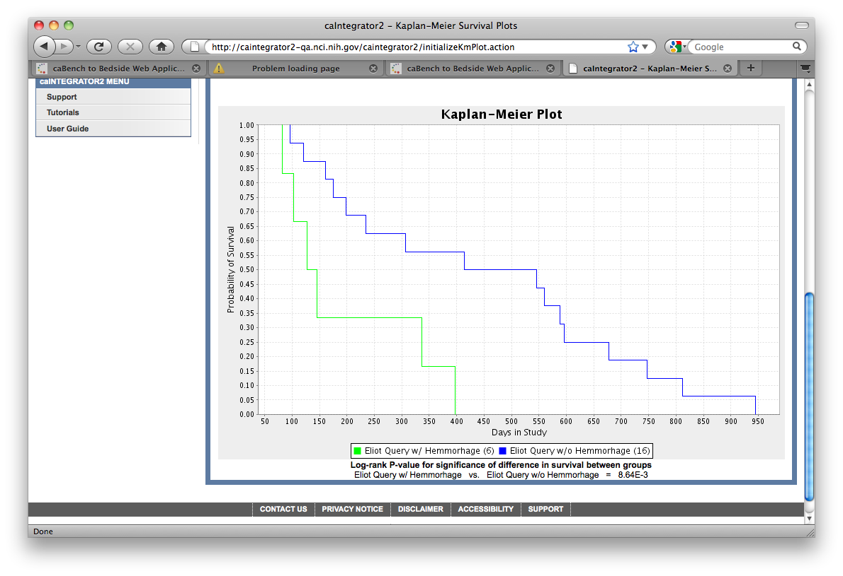
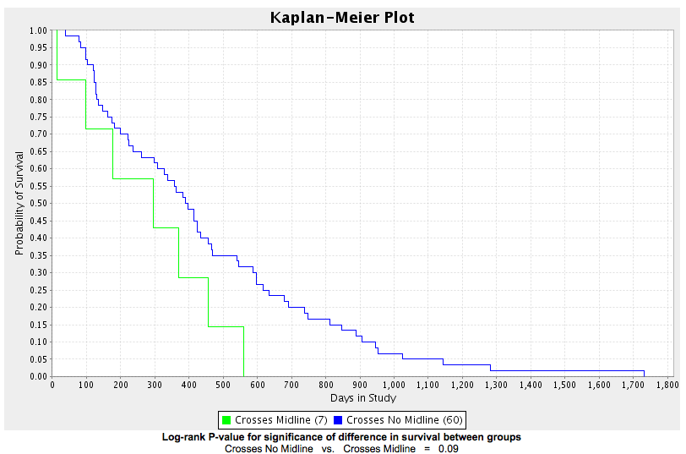
Achievements: Preliminary Scientific Findings
Survival of patients with greater thickness of enhancement (who appear to have had tumors with a thicker “rim”) was significantly for shorter than those who had less.
Survival of patients who had larger thickness of enhancement tumors with hemorrhage was significantly for shorter than those who did not.
Survival of patients who had tumors that crossed midline was significantly for shorter than those who did not.

Slide 13
Opportunities to Further Deploy TCGA Related Imaging and Life Sciences Technologies
Cancer Imaging Program:
- Continued TCGA Genotype/Phenotype Research with CBIIT, NIH Clinical Center
- Quantitative Imaging Network Program
- Cancer UK Research Program
- All Ireland Initiative Program
Radiation Research Program
- RTOG 0522 Study
NIAMS Osteoarthritis Study
- Annotation of radiology data
- Integrating of radiology data with other OAI data types

Slide 14
How the TCGA Radiology Project Fits Into the caBIG® Imaging Program Roadmap
The Workstation provides a template for the type of visualization service that we wish to make available as part of the suite of Imaging web-based services.
The AIM Data Service is part of the proposed suite of web-based services offered by CBIIT.
All of the TCGA technologies are part of the proposed software refactoring for SAIF/ECCF compliance.
Robert and Mervi have collaborated to get AIM capability into caIntegrator2.

Slide 15
Proposed Next Steps for TCGA Radiology
Proposed Next Steps Beyond Current Project
Ongoing operation and maintenance of NBIA, Clear Canvas, AIM Data Service and TCGA Cancer Cell Data Service.
Communication to community that radiologists can read the cases and add to the AIM TCGA data set. CIP says they are recruiting additional radiologists to read the cases. CIP also says that are working with TCGA sites to get additional TCGA radiology cases to be loaded on CBIIT’s NBIA.
Create a hosted instance of AIM Data Service, and TCGA Cancer Cell Data Service at CBIIT.
Communication to community that researchers can query across the three data services. CIP is also working with Carl Schaefer and Robert Clifford to begin to do research correlations among the clinical, genomic and image annotation data.
Solicit feedback from community regarding desired features for the Workstation and AIM Data Service.

